Slide 1
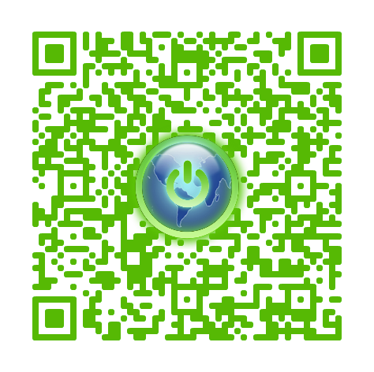
Download Us
The Guardian Project
The Guardian Project
https://guardianproject.info

Slide 2


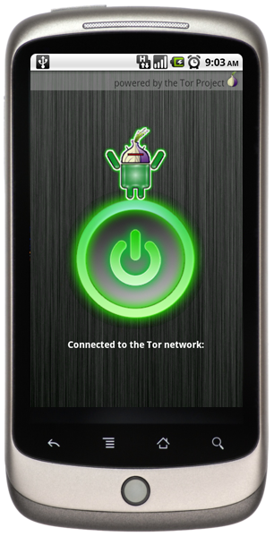
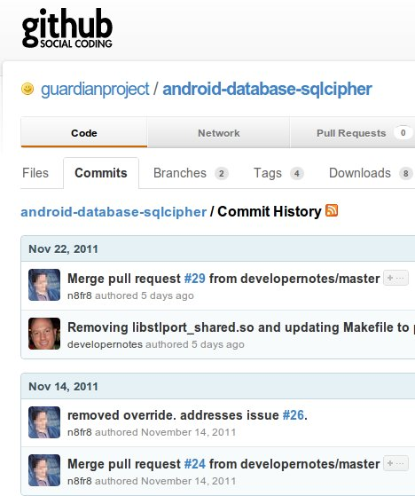
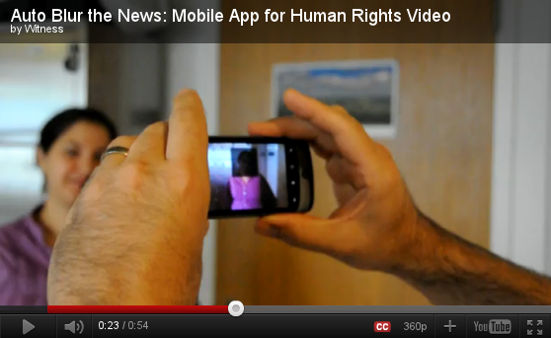



Open-Source
Mobile Security R&D
Consumer Apps and customized HW+SW for NGOs, Activists & Journalists
Partnerships, Training & Advocacy

Slide 3











Guardian is a research and development effort powered by technology-focused activists, concerned citizen users, and open-source security software hackers. It is built upon real world experience and feedback, and our process is transparent, inclusive and responsible.

Slide 4
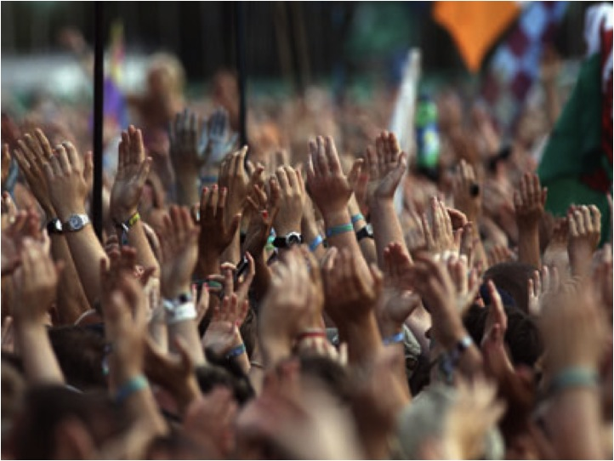

Everyday Mobile Internet Freedom
Mobile users in censorship states can use Guardian apps to get around the content filters, firewalls and monitors. Everyday citizens use the apps to watch online video, read blogs, communicate safely with friends, and otherwise access whatever content they would like, encouraging open society and culture.

Slide 5
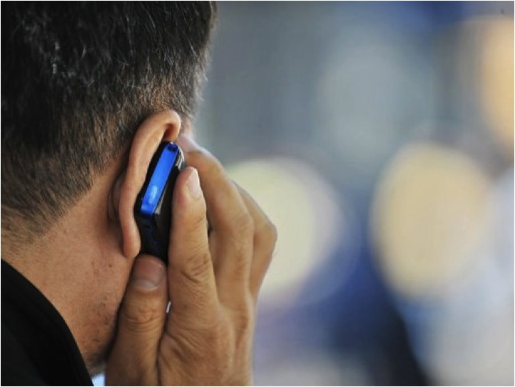

Business
Business people travel all over the world, using foreign networks, bandwidth and systems. At any point, confidential information can be compromised. While some organizations implement solutions, these are often expensive, difficult to use, and not comprehensive

Slide 6


Activists + Citizen Journalists
Tech savvy citizen journalists and activists in the street use Guardian apps to share updates, photos and videos without interception or monitoring by the authorities.

Slide 7
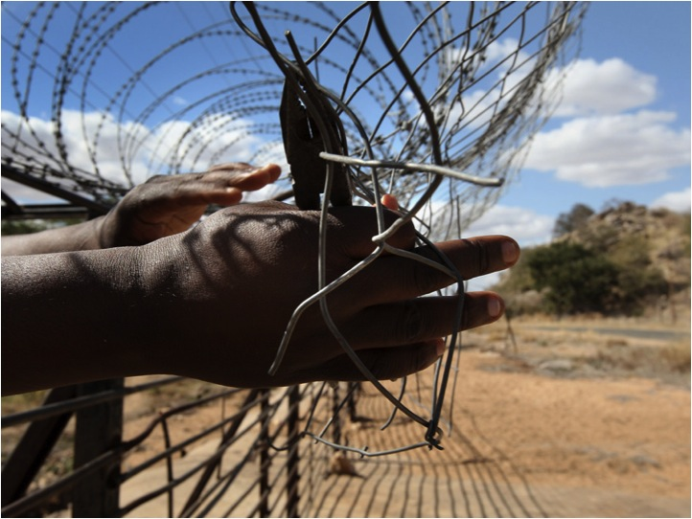

Human Rights Defenders
An undercover human rights researcher traveling through a remote region without mobile data service is able to use Guardian to document local conditions using secured video, audio and photo capture. Data is stored encrypted on the device, and if necessary, it can be safely and quickly erased.

Slide 8

The Guardian Project aims to create easy to use mobile apps, open-source firmwares, and customized, commercial mobile phones that can be used and deployed around the world, by any person looking to protect their communications from unjust intrusion.
Whether your are an average citizen looking to affirm your rights or an activist, journalist or humanitarian organization looking to safeguard your work in this age of global communication, Guardian is the solution for your mobile security needs.

Slide 9
Download Us
The Guardian Project
The Guardian Project
https://guardianproject.info

